Slide 1

Drone positioning via feature detection on aerial images taken at flight time
Galanis Achilleas-Alexandros-Vasileios
Department of Electrical and Computer Engineering
School of Engineering
University of Thessaly
Examination Committee:
Spyros Lalis
Professor
Department of Electrical and Computer Engineering
Christos D. Antonopoulos
Professor
Department of Electrical and Computer Engineering
Nikolaos Bellas
Professor
Department of Electrical and Computer Engineering

Slide 2
Introduction
Drones, also known as Unmanned Aerial Vehicles (UAVs) are increasingly important for various applications.
These apps require accurate and dependable navigation features, typically supplied by Global Positioning Systems (GPS).
Conventional GPS systems, although widely used and reliable, can be affected by different disturbances like physical barriers, buildings, thick foliage, or bad weather.
If a drone loses its GPS signal, it often does not have another way to navigate, resulting in emergency landings in possibly unsafe or unplanned areas, like rough terrains, bodies of water, or even populated spaces.
Thus, not having a dependable backup navigation system can lead to failure of the mission, loss of important data, and significant financial setbacks.

Slide 3
Focus
Discover an alternative navigation system that can provide positional information, enabling drones to continue their mission or guide them safely back to their starting point.
Create a mechanism that infers the position of the drone based on information extracted from aerial images taken during flight using the drone’s onboard camera. A feature detection method is used to identify the key features of each image taken as the drone flies above a certain region. Each detected feature is kept in a list and is assigned a GPS coordinate based on the known position of the drone (via GPS).
If the GPS signal is lost, the position of the drone can be inferred following the reverse approach.

Slide 4
Contributions
01
02
03
04
Explore the usage of feature detection on aerial images to infer the position of a drone, as backup navigation.
Describe a concrete implementation of this approach.
Experimentation using ardupilot’s software-in-the-loop autopilot configuration and the Gazebo simulation environment.
Evaluate the proposed approach through a series of experiments for different scenarios.

Slide 5

Related work
Visual Odometry and Feature Detection Techniques

Slide 6
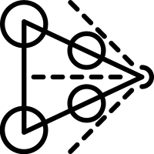
Visual Odometry
Visual odometry is a reliable method used by drones to accurately determine their location using just a continuous series of pictures taken by a camera mounted on the vehicle. It is considered a cost-effective and relatively accurate alternative to traditional odometry techniques like GPS, INS, and wheel odometry.

Slide 7




Types of VO
Monocular
Stereo
Omnidirectional
RGB-D
Visual odometry can be classified according to the type of camera sensor utilized
Utilizes a single camera.
Suffer from scale ambiguity.
Utilizes two cameras.
Captures depth info, it has increased quality of distance estimation and motion.
Utilizes wide-angle cameras (up to 360° fov)
more scene information to be available -> extended feature tracking.
Combines color and dense depth image capturing.
Very well in indoor environments but are limited to short ranges.

Slide 8
Challenges of VO
Computational Cost
Dynamic Environments
Environmental Conditions
Featureless Environments
Sensor Noise and Distortion

Slide 9
Approaches of Vo
Feature-based
Appearance-based
Hybrid-approach
Identify certain image features like corners, lines, and curves in a pair of consecutive image frames.
Then, they are matched through feature tracking to estimate motion.
This is based on differences in pixel appearance and brightness intensity between frames.
Combines the strengths of both feature-based and appearance-based methods.
Tracks points of interest in consecutive image frames and simultaneously utilizes pixel intensity information.
Particularly advantageous in those environments where any one method may fail.

Slide 10
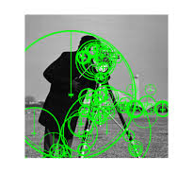
Our Approach
Not a VO technique.
Uses feature-based techniques from visual odometry to accurately determine the drone’s location by detecting and matching features.
Then the data can be used for any mission we want (waypoint navigation, return to home etc.)

Slide 11
Feature detection approaches
Scale-Invariant Feature Transform (SIFT). | The SIFT algorithm was developed by David Lowe in 1999 for detecting and describing local features in images. SIFT is invariant to image scale and rotation, being robust to changes in illumination and minor affine distortions.
Speeded-Up Robust Features (SURF). | SURF is a robust image descriptor that enhances SIFT. Devised by Herbert Bay and his team in 2006, SURF has been engineered to speed up calculations while upholding reliability and precision.
Features from Accelerated Segment Test (FAST). | High-speed corner detection technique that was developed by Edward Rosten and Tom Drummond in 2006.

Slide 12
Feature detection approaches
Binary Robust Invariant Scalable Keypoints (BRISK). | The BRISK algorithm, developed by Stefan Leutenegger and his team in 2011, is a method for detecting and describing features that is efficient and robust.
Oriented FAST and Rotated BRIEF (ORB). | ORB is derived from the FAST keypoint detector and the BRIEF descriptor. Ethan Rublee, along with his group, developed this design in 2011; the notion was to create a design that was efficient with low computational cost for real-time applications.

Slide 13

Approach
High-level description of our algorithmic approach and implementation details.

Slide 14
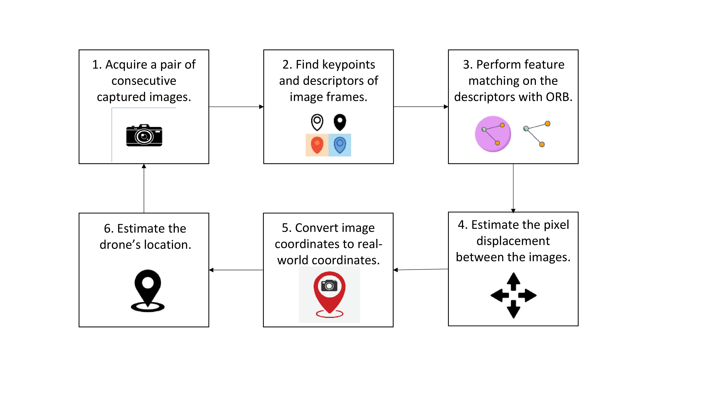
Our algorithm

Slide 15
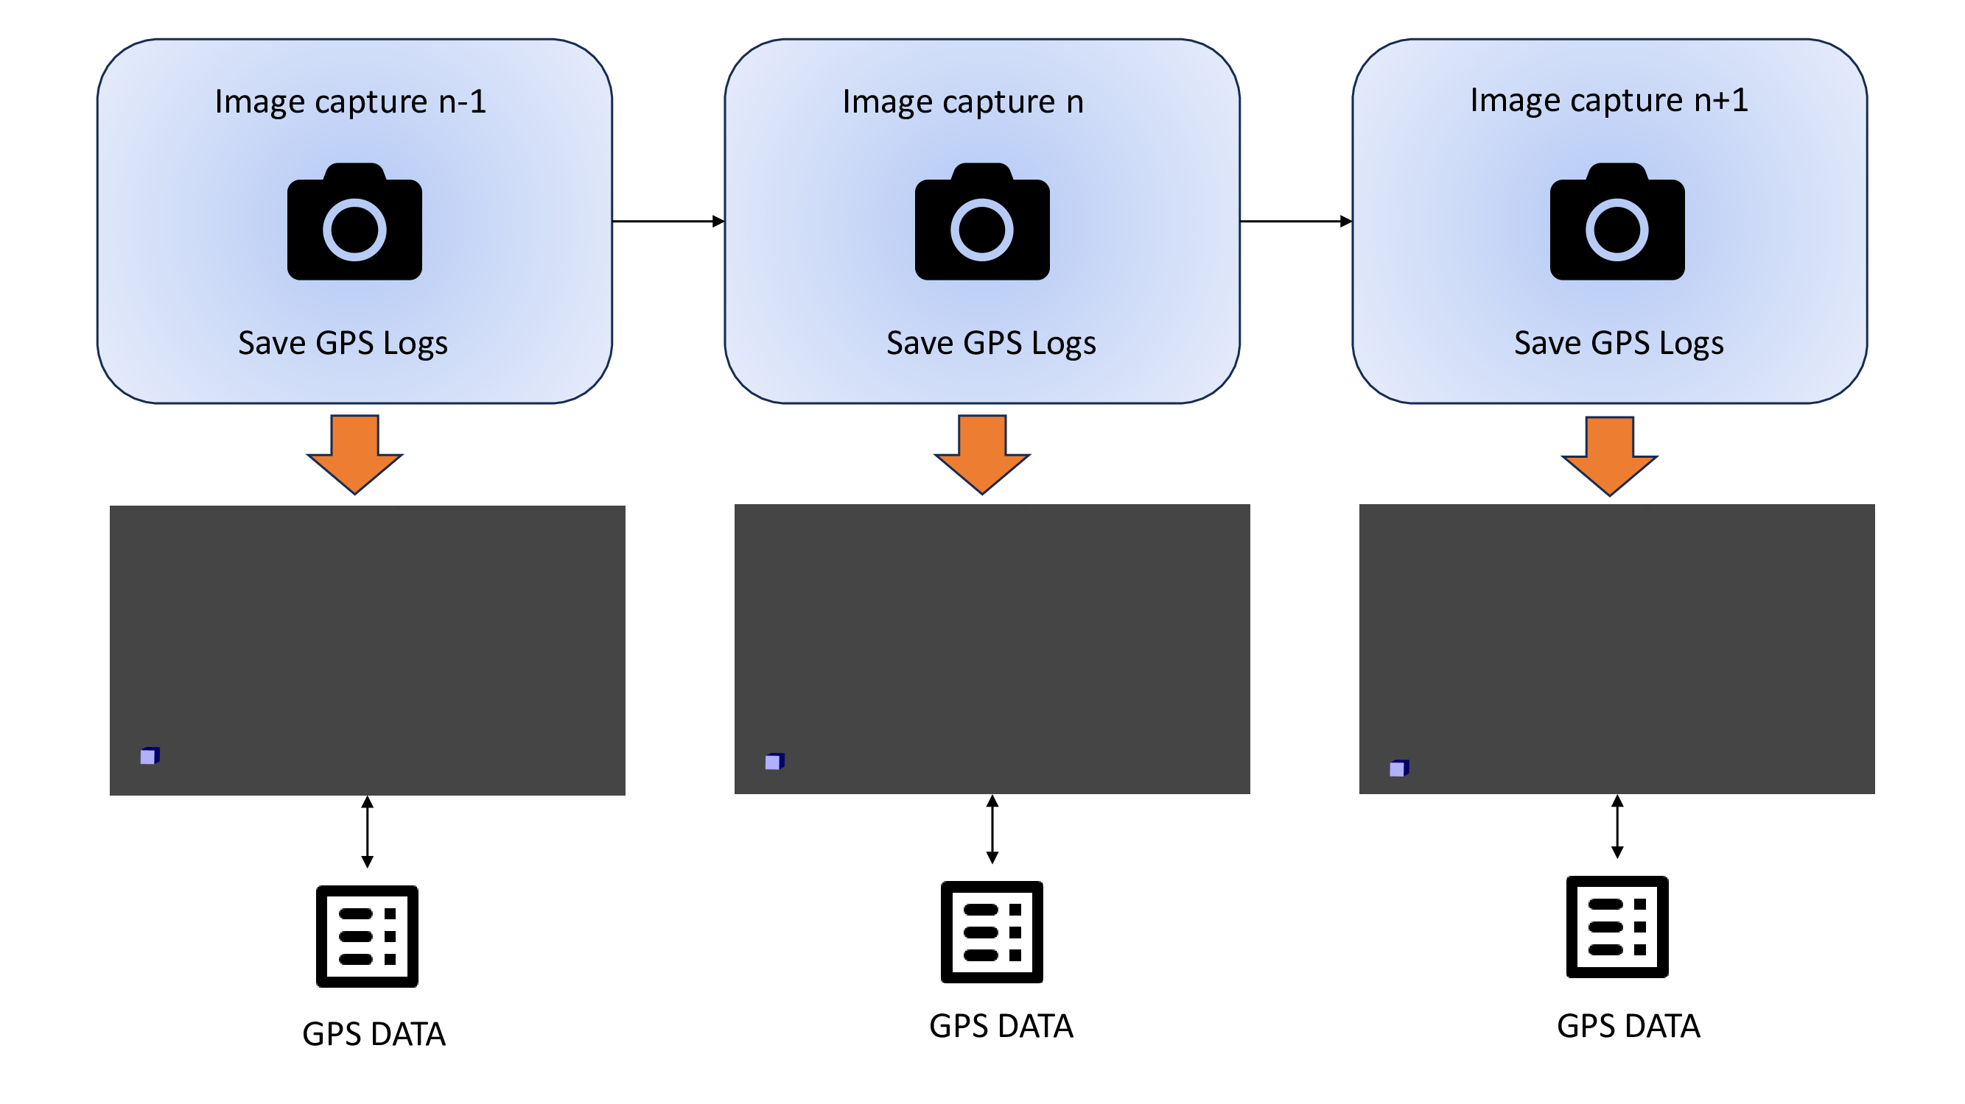
Image capture

Slide 16
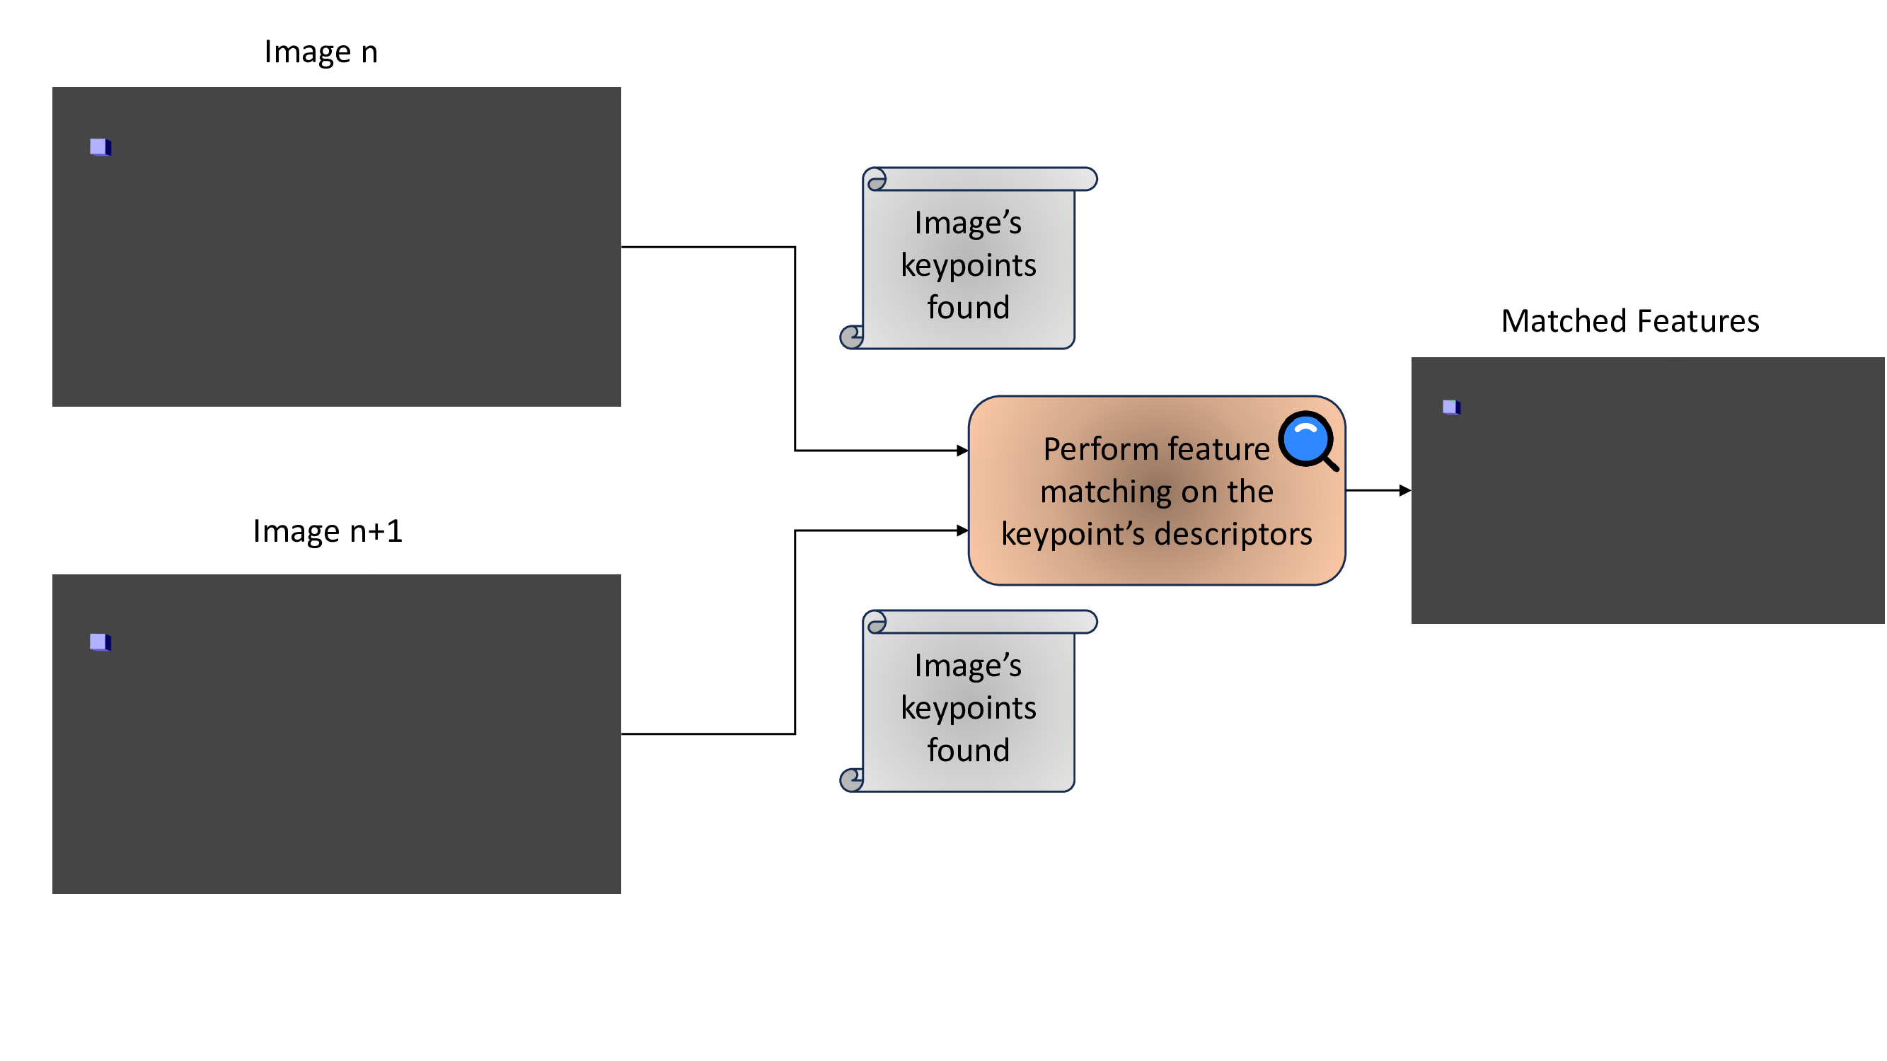
Feature detection and matching

Slide 17
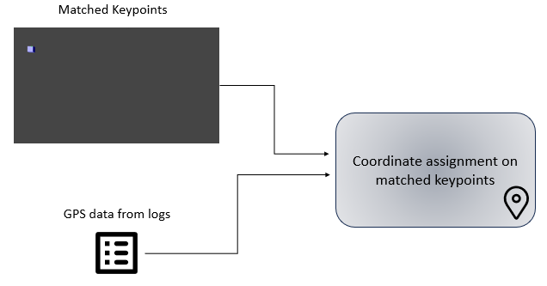
Coordinate assignment

Slide 18
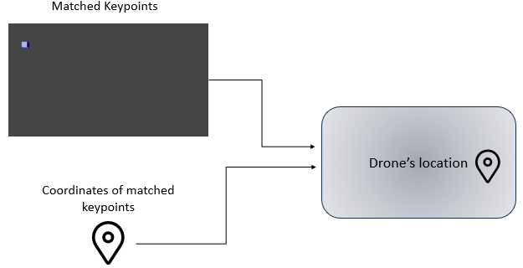
Drone positioning

Slide 19

Camera parameters
The camera position is under the drone and has an orientation of 90 degrees, meaning it faces downwards to the ground.
HFOV = 90 degrees.
VFOV ≈ 58.7 degrees.
Image Resolution = 1280x720.
30 fps update rate

Slide 20
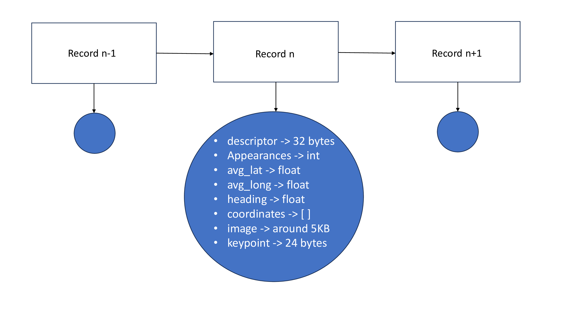
Data structure for coordinate assignment

Slide 21
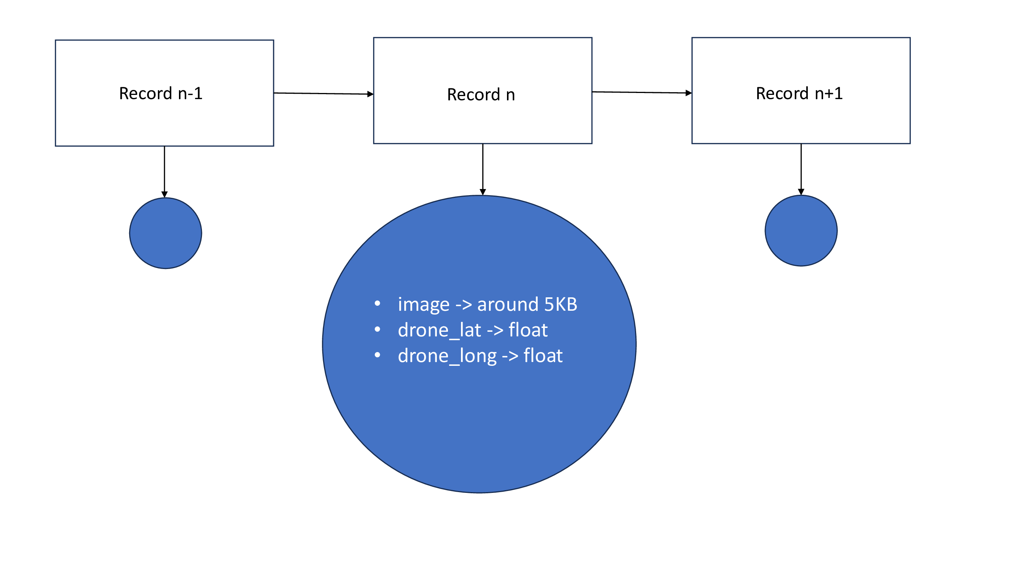
Data structure for drone positioning

Slide 22

Experimental setup
ArduPilot SITL, Gazebo simulation environment and testing scenarios.

Slide 23
ArduPilot SITL
ArduPilot SITL (Software In The Loop) simulates ArduPilot’s autopilot software on a computer without the use of hardware.
Compiles autopilot code with a standard C++ compiler to create a native executable.
Crucial for testing and development, allowing replication of planes, copters, and ground rovers.
Can connect to other simulators for advanced physics, graphics, and complex scenario testing.
Supports emulation of various sensors and peripherals for testing sensor fusion algorithms.
Used to simulate the autopilot control system of a drone for flight and navigation.

Slide 24
Gazebo simulation environment
Gazebo is an open-source simulation environment for robotics testing and development.
Features advanced physics, 3D visualizations, and sensor models (e.g., cameras, IMUs).
Supports robot design modification using Simulation Description Format (SDF).
Offers programmatic and graphical interfaces for simulation control.
Allows custom plugins for extended functionality and complex behaviors.
Integrates with Robot Operating System (ROS) for testing algorithms and robotic behaviors.
We used Gazebo to set up the experimental environment with a drone model.

Slide 25
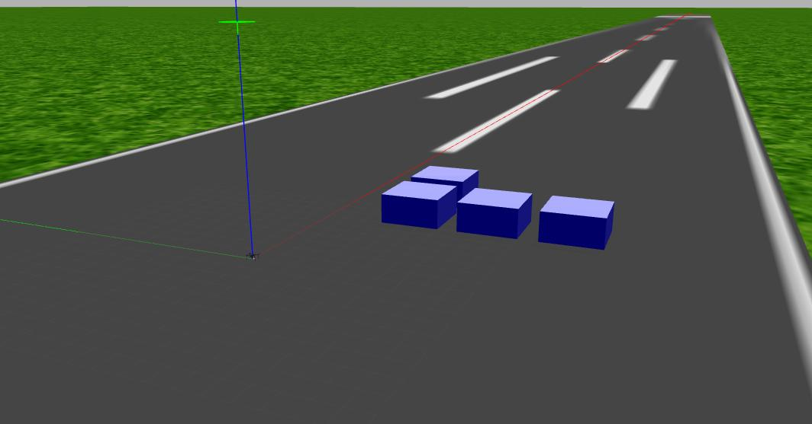
Experimental setup

Slide 26
Drone model
The IRIS quadcopter by 3D Robotics was chosen for executing and testing algorithms.
It is a ready-to-fly UAV with the advanced Pixhawk autopilot system.
Features include multiple controls (RC, computer, phone, tablet), real-time telemetry, robust Zytel Nylon construction, custom commands, GPS waypoint navigation, and GoPro compatibility.
Gazebo supports the IRIS quadcopter's physics model for realistic simulations of flight dynamics.
The IRIS quadcopter model in Gazebo accurately reflects the physics and aerodynamics of the actual drone.
We implemented the IRIS quadrotor drone model in Gazebo and connected it with the drone autopilot system.

Slide 27
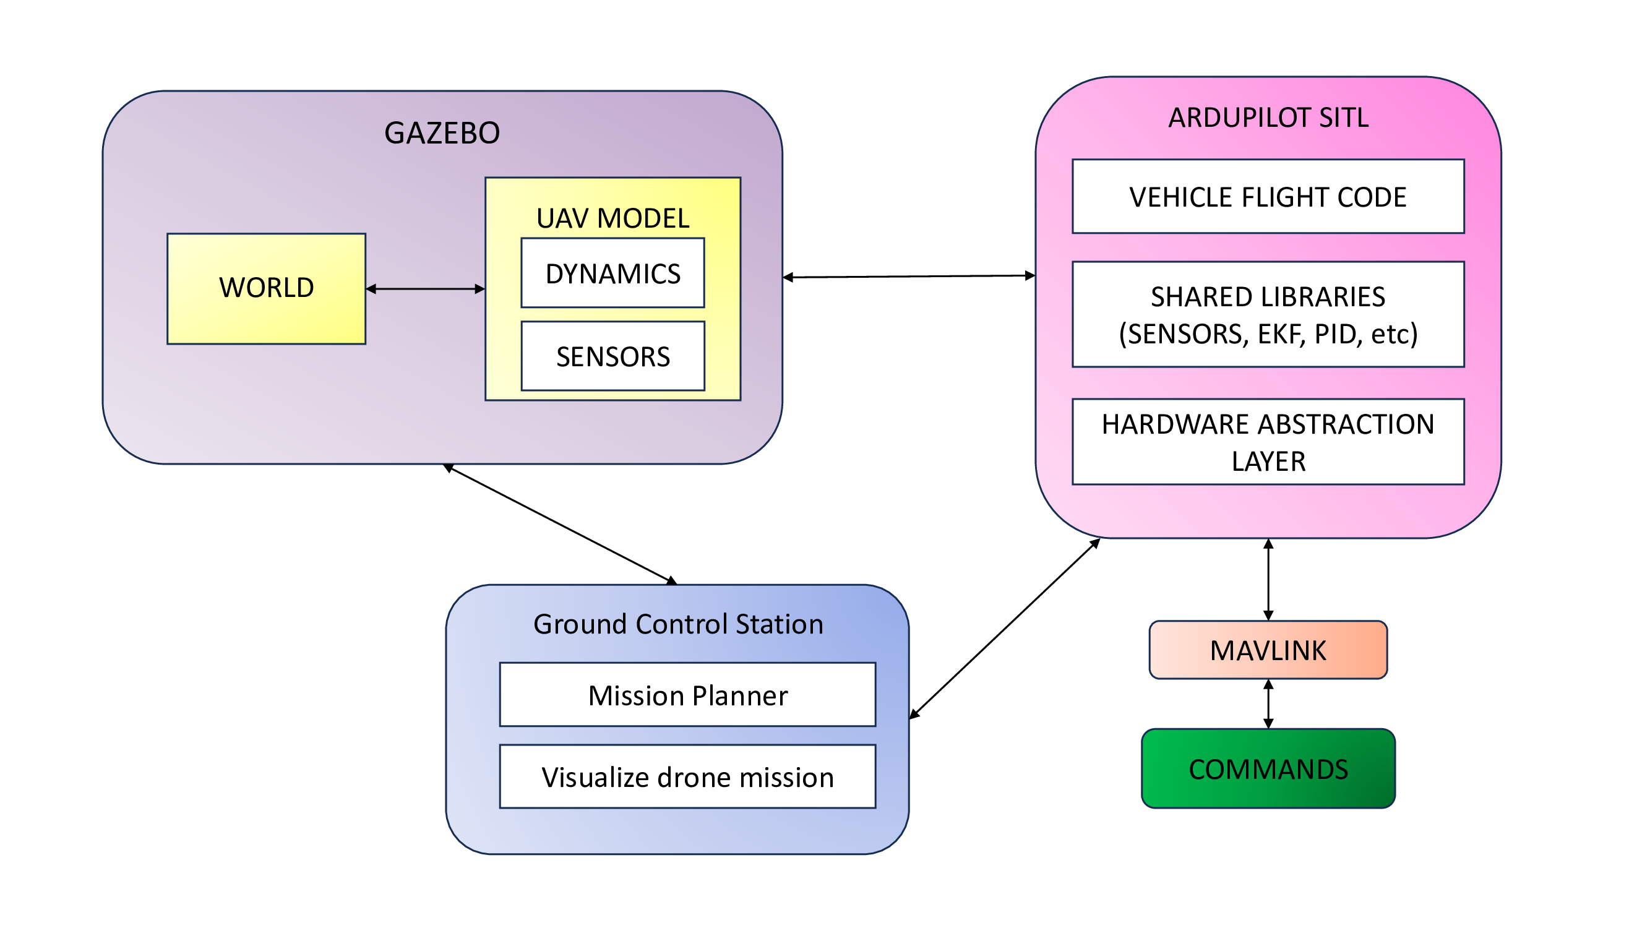

Slide 28
Camera model
Users can create plugins in Gazebo to enhance simulations, such as virtual cameras and camera streams.
Virtual cameras simulate physical cameras by producing image data from simulated scenes.
They have configurable properties like resolution, field of view, and frame rate to model physical camera capabilities.
Perfectly integrates with Robot Operating System (ROS) allowing easy communication between Gazebo and ROS software.

Slide 29
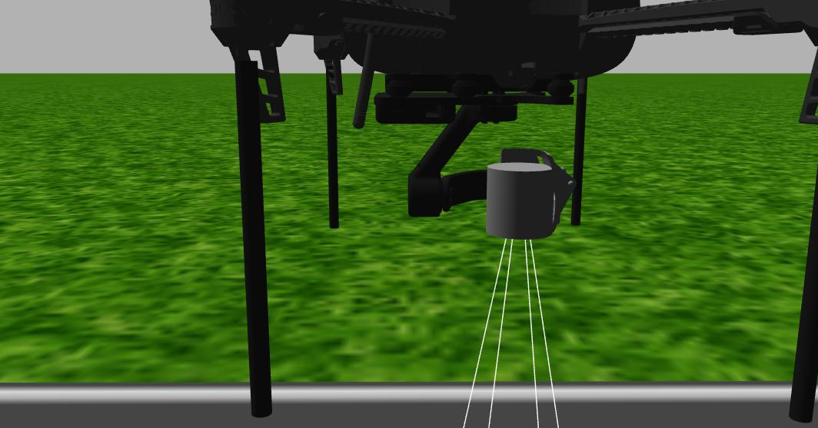
Experimental setup

Slide 30
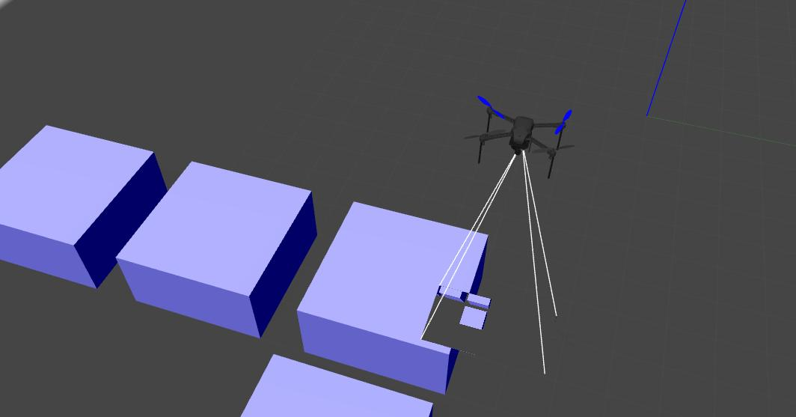
Experimental setup

Slide 31
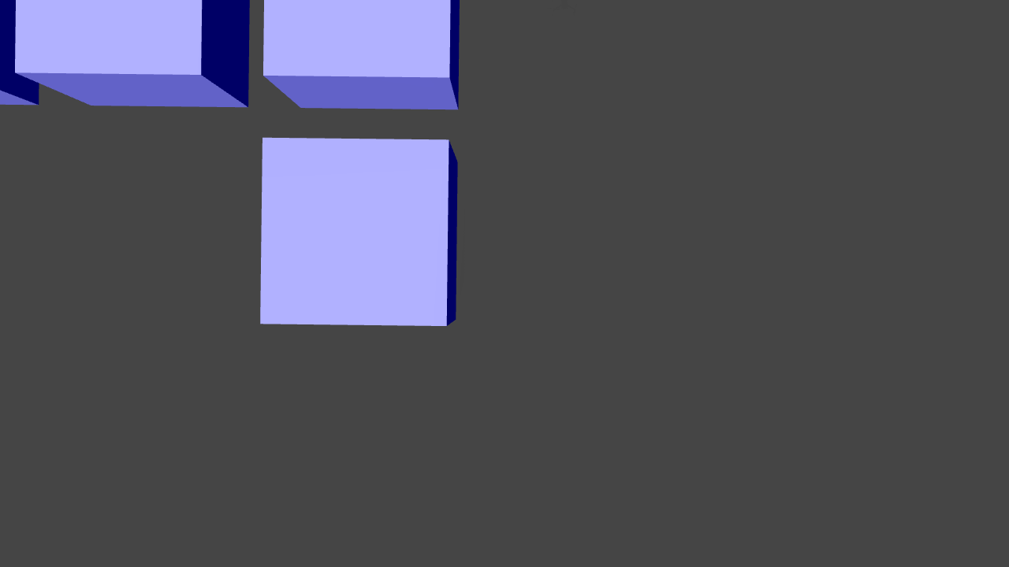
Experimental setup

Slide 32
Drone mission
Mission Description:
Objective: Collect data for feature detection and matching algorithm.
Pattern: Square scan, similar to a lawnmower pattern.
Area: 20 meters by 20 meters.
Spacing: 2 meters between horizontal movements.
Speed: Low, to minimize tilt on the z-axis for accurate data collection.
Types of Missions:
Missions with one object of varying sizes and altitudes.
Missions at a fixed altitude with different numbers of objects, sizes and colors.

Slide 33
Mission scenarios
One Cube Scenario:
Simpler and straight-forward.
Focus on a single cube with varying sizes: 0.5x0.5x0.5, 1x1x1, 2x2x2, 3x3x3.
Flying altitudes: 10 meters and 15 meters.
Conducted 5 runs for each parameter combination to observe algorithm performance.
Multiple Cubes Scenario:
Transitioned to more realistic scenarios with multiple cubes.
Flying height: 15 meters.
Varied number and color of cubes. We tested with 2, 3, and 4 cubes.
Cube sizes: 0.5x0.5x0.5 and 3x3x3.
Conducted 3 runs for each parameter combination to evaluate algorithm performance in complex scenarios.

Slide 34
Evaluation
Result analysis and discussion

Slide 35
Accuracy calculation
Chosen method: Complete the drone mission, then calculate accuracy based on the average coordinates of matched features (averaging provides more precise geographical coordinates). When a feature is detected multiple times (e.g., 20 times), averaging the coordinates improves accuracy compared to a single detection.
Compare the algorithm’s average latitude and longitude with the pre-determined coordinates captured during the mission.
Only results with more than 10 detections are considered statistically relevant and used for the coordinate assignment algorithm.
The drone positioning algorithm reverses the coordinate assignment process.
The average position of the drone is calculated after the mission using only the statistically relevant results and compared to the expected position to determine accuracy. (The coordinates calculated by the algorithm after processing each image pair will be the same as those logged by the drone during the mission).

Slide 36
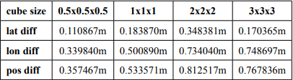
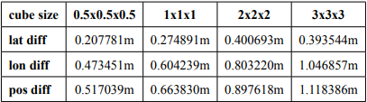
Results with respect to accuracy for CA
1 cube mission coordinate assignment results for 10 meters.
1 cube mission coordinate assignment results for 15 meters.

Slide 37
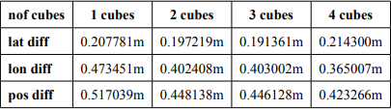
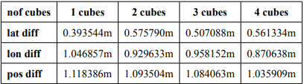
Results with respect to accuracy for CA
Multiple cube mission coordinate assignment results with different color and 0.5x0.5x0.5 cube size.
Multiple cube mission coordinate assignment results with different color and 3x3x3 cube size.

Slide 38
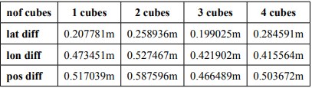
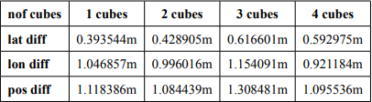
Results with respect to accuracy for CA
Multiple cube mission coordinate assignment results with same color and 0.5x0.5x0.5 cube size
Multiple cube mission coordinate assignment results with same color and 3x3x3 cube size.

Slide 39
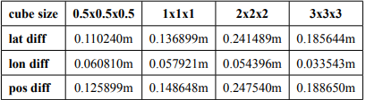
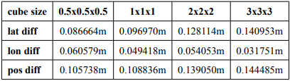
Results with respect to accuracy for DP
1 cube mission drone positioning results for 10 meters.
1 cube mission drone positioning results for 15 meters.

Slide 40
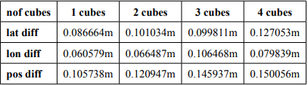
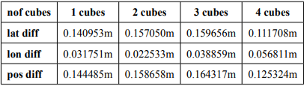
Results with respect to accuracy for DP
Multiple cube mission drone positioning results with different color and cube size 0.5x0.5x0.5.
Multiple cube mission drone positioning results with different color and cube size 3x3x3x.

Slide 41
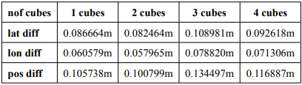
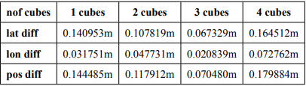
Results with respect to accuracy for DP
Multiple cube mission drone positioning results with same color and cube size 0.5x0.5x0.5.
Multiple cube mission drone positioning results with same color and cube size 3x3x3x.

Slide 42
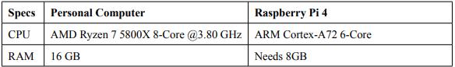
Performance evaluation
Objective: Measure the algorithm's execution times during a single drone mission.
Importance: Determine feasibility on both high-end PCs and onboard hardware, such as a Raspberry Pi 4.
Metrics: maximum iteration time, minimum iteration time, average time per iteration, total time.
Goal: Assess if the algorithm is suitable for integration into the drone's onboard software.

Slide 43
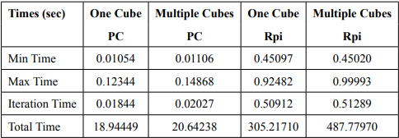
Results with respect to performance
Comparison of average times (in seconds) for one-cube and multiple-cube missions on PC and Rpi.

Slide 44
THANKS!
Do you have any questions?

